Slide 1
Project 4
Mary, Jess, Sarah, Galen

Slide 2
Overview
Project Objective: | Investigate factors driving house prices in Ames, Iowa
Data: | Kaggle dataset for Ames Housing
Methods: | Analysis Tableau analysis Cluster analysis Machine Learning price prediction model Tech Host data on S3 Model in Colab Develop

Slide 3
Results – Data Visualization
Screenshots of top 3 findings here

Slide 4
Results - Clustering
Screenshots of clusters here
Elbow plot
3-4 clusters based on different variables

Slide 5
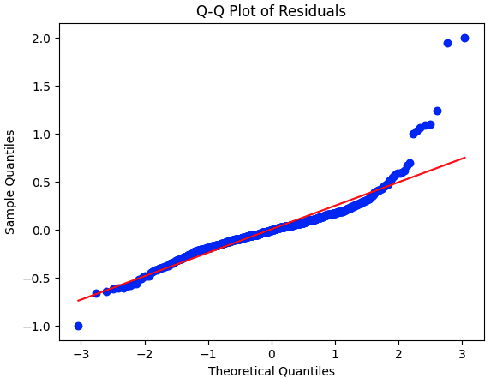
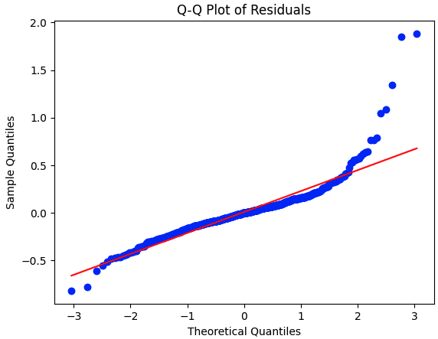
Results - Modeling
Trained Linear Regression & XG Boost
Q-Q plots suggest there is an interaction or variable not accounted for in the model; overall good fit
Linear Regression was powerful out of the box, more complex models only gave marginal gains
Linear Regression
XG Boost
Training R-Squared: 0.9401
Testing R-Squared: 0.9397
Mean Squared Error: 0.0695
Best Parameters: {'learning_rate': 0.1, 'loss': 'huber', 'max_depth': 3, 'n_estimators': 200, 'subsample': 1.0}
Training R-Squared: 0.9676501961674518
Testing R-Squared: 0.9501703258657423
Mean Squared Error: 0.05743137013095087

Slide 6
Demo Time
Predictions Webpage
Report Webpage

